Slide 1


LUWERIOUSHOTEL
Welcome to our presentation!

Slide 2
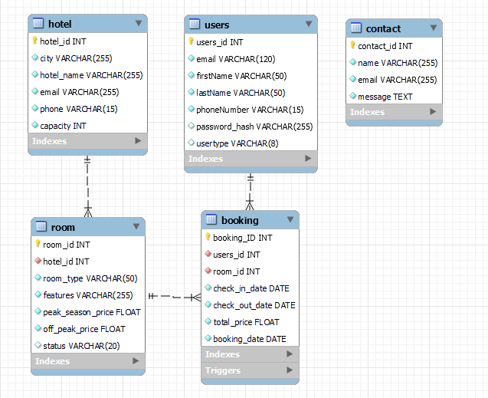


Database Design

Slide 3
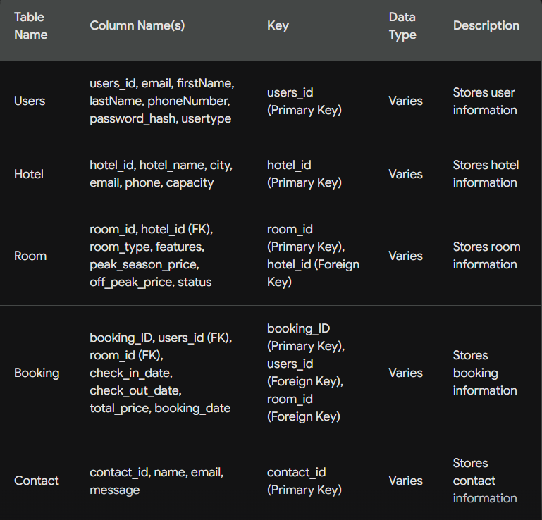
Database Design Explaination
1NF: 1st Normal Form eliminates repeating groups and ensures atomicity of data.
2NF: 2nd Normal Form is achieved by removing partial dependencies, meaning each non-prime attribute is fully functionally dependent on the primary key.
3NF: 3rd Normal Form ensures that there are no transitive dependencies, where non-prime attributes depend on other non-prime attributes.

Slide 4

L.E.S.P ISSUES
(Legal, Ethical, Social, Professional)

Slide 5

Comply with the GDPR's principles for data collection, processing, and storage.
01
LEGAL
Encrypt all passwords via password hashing.
All images used within the project are for educational purposes.
Only store important information - some will be retained for longer periods of time while some will be anonymized within a few months - and use it for legitimate reasons.
Display clear and concise Terms and Conditions when signing up.
Use CAPTCHA verification.

Slide 6

02
Minimize website footprint by using a small amount of images and not including advertisements to cut down energy usage.
ETHICAL
Collect and retain only the data necessary for legitimate business purposes, minimizing unnecessary data collection.
Implement efficient codes and resource optimization techniques to reduce the amount of data transferred between our server and users' devices.

Slide 7

Are designed based on four key principles: Perceivable, Operable, Understandable, and Robust.
03
SOCIAL
Emphasize Accessibility and Usability by implementing a clear navigation, user-friendly searching feature, and different device compatibility.
Integrate social media buttons (Facebook, Instagram, Twitter) to encourage guests to share experiences and connect with the hotel website.

Slide 8

04
Prioritize Legal, Ethical, and Social compliance by adhering to ethical data collection and privacy practices, while promoting inclusivity and social responsibility in design and content.
PROFESSIONAL
Follows Web technology standards and best practices by employing well-tested and reliable technology solutions, secure coding practices and frameworks to ensure protection against vulnerabilities.
Meets functional requirements by providing booking functionality, information provision, and user interaction.

Slide 9

Test cases
Test case | Purpose | Inputs | Expected result | Actual output
Payment without an account | Make sure an user must have an proper account to book a room | Click ‘Booking’/’Book Now’ then ‘View Rooms’ then ‘ Add to booking’ while not logged in | Automatically goes back to log in page | As expected
Sign up errors | To check all error when signing up such as: email invalid, wrong CAPTCHA, password not match, phone number invalid, ... | Wrong email format Wrong CAPTCHA 2 different passwords 2-number phone number | Displays error messages for various errors | As expected
Inappropriate check-in/ check-out time | Ensure that users enter correct time for check-in/check-out | Any check-out time prior to the designated check-in one | Requires users to enter check-in/check-out time again | As expected
Book an already booked room | A booked room cannot be booked anymore | Book a room, go to home page then book that exact room | The room status would be ‘Booked’ and the room cannot be booked | As expected
Use an user account to control the admin dashboard | Prevent every users account to | Add “/admin/dashboard” in the route | Error message “Unauthorized Access” being displayed | As expected

